Slide 1

PAC

Slide 2

W2W
What is expected ?
Notes:
What is expected ?

Slide 3
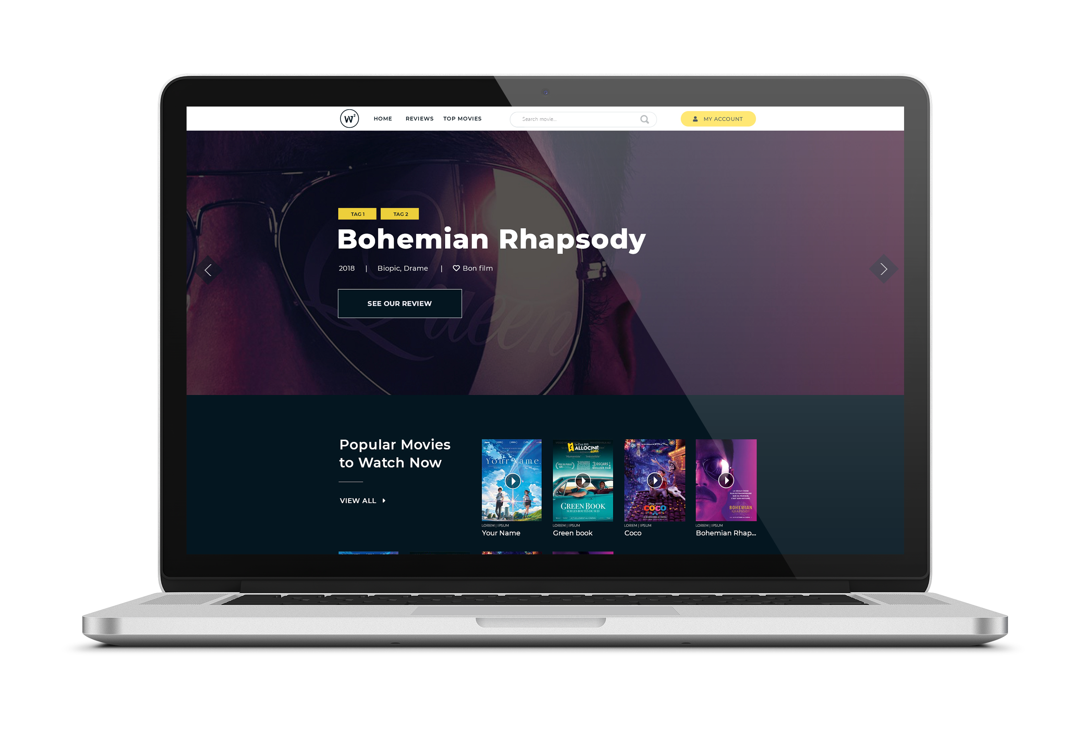
W2W
What is expected ?
Notes:
Proof of Concept

Slide 4

W2W
What is expected ?
Notes:
Proof of Concept

Slide 5
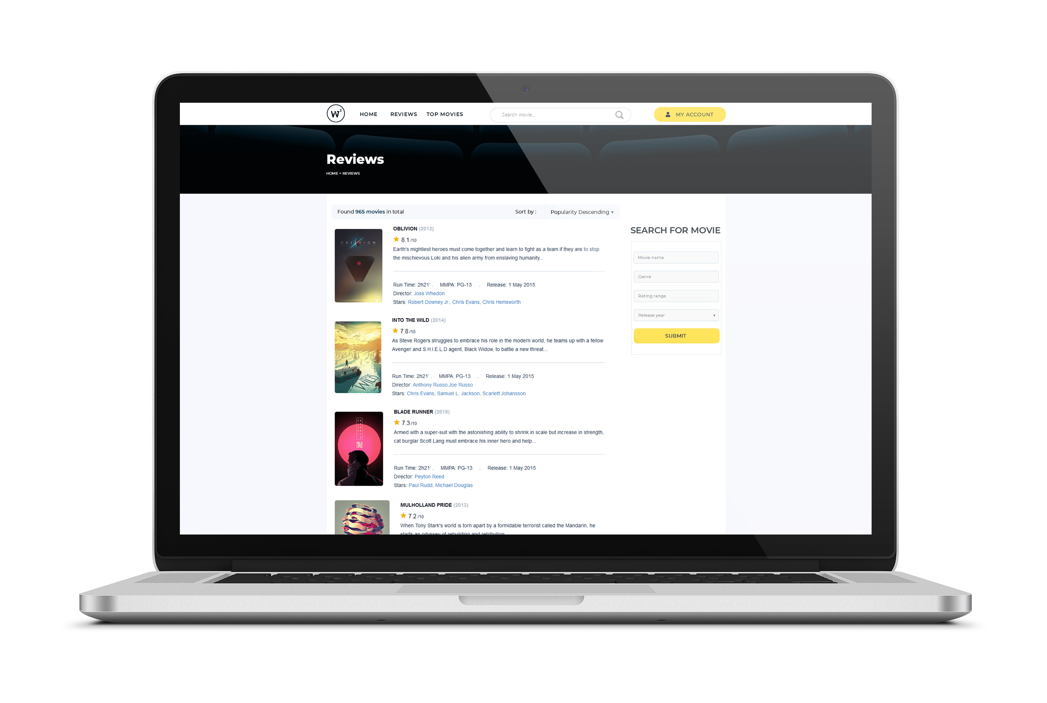
W2W
What is expected ?
Notes:
Proof of Concept

Slide 6
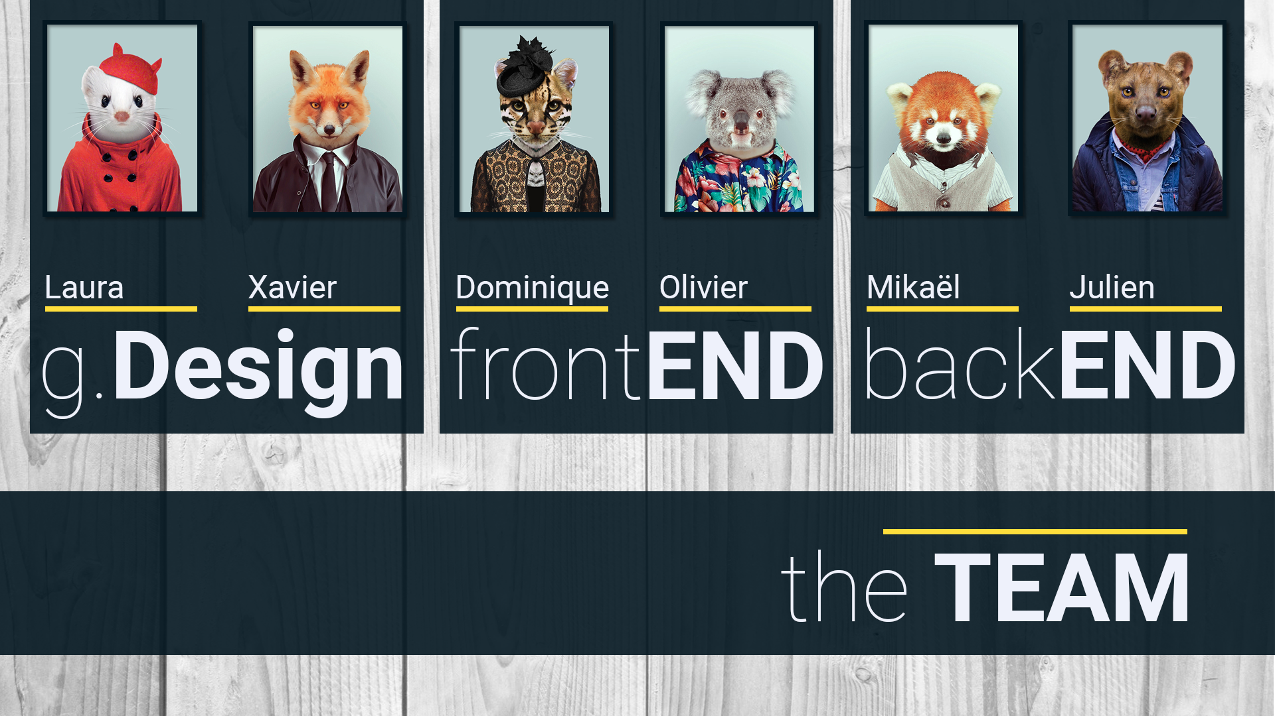
How ?
Notes:
How we wanted to do it ?

Slide 7

Challenges
Notes:
Challenges

Slide 8

Notes:
Working alone, not as a team

Slide 9


Notes:
How to fix it ?

Slide 10

Notes:
Working together, communication, mails.

Slide 11
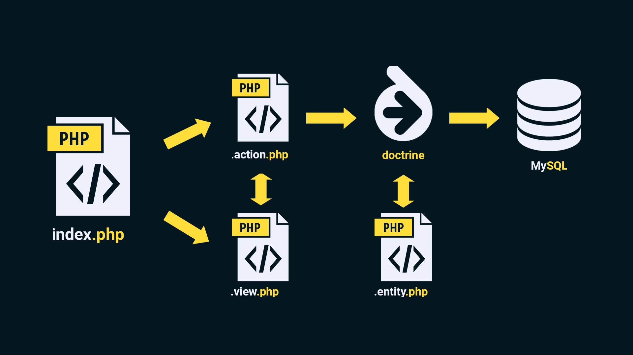
Final Structur
Notes:
Final structure

Slide 12
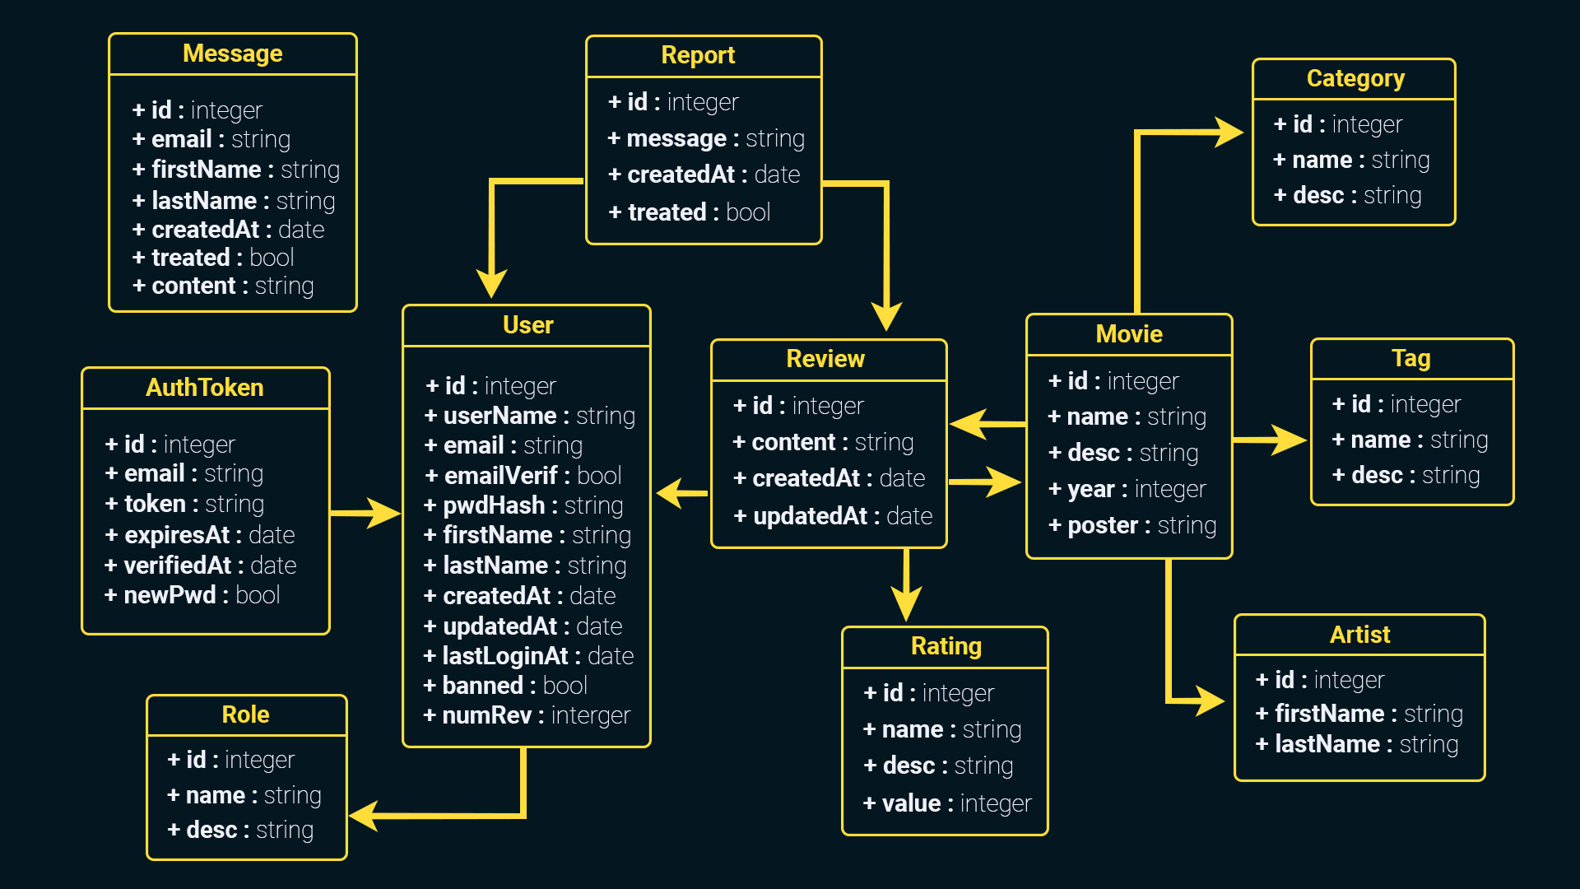
Diagrams
(concept)
Notes:
Diagram

Slide 13
Back-end

Slide 14
Html/css

Slide 15
Design

Slide 16

Demo

Slide 17

Are we paid ?
Notes:
Are we paid ?

